Slide 1
Final Project – DSC530
Kalaivani Kalyanasundaram

Slide 2
Dataset
This is a heights data frame that includes factors affecting height.
Key variables: height, earn, sex, ed, and age

Slide 3
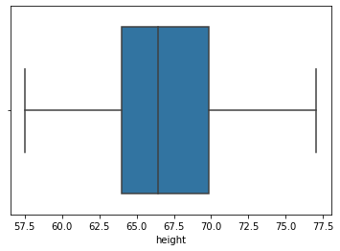
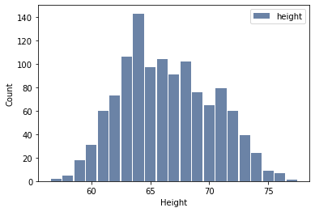
Height
This variable represents the height of individuals.
Roughly symmetric with no apparent outliers
Mean: 66.91515376107574 Median: 66.4512652109843 Mode: 74.4244387818035

Slide 4
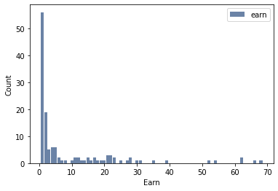
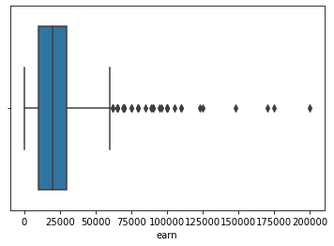
Earn
This variable represents the earning of individuals.
Skewed right with many outliers
Mean: 23154.773489932886 Median: 20000.0 Mode: 15000.0

Slide 5
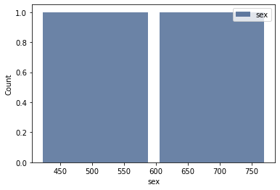
Sex
This variable represents the sex of individuals.
Bimodal with no outliers and descriptive statistics as it is a string

Slide 6
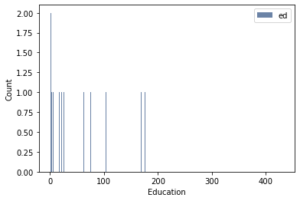
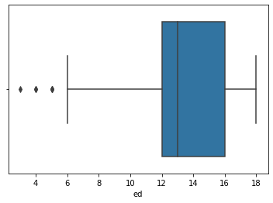
Ed
This variable represents the education level of individuals.
Skewed right with a few outliers
Mean: 13.504194630872483 Median: 13.0 Mode: 12

Slide 7
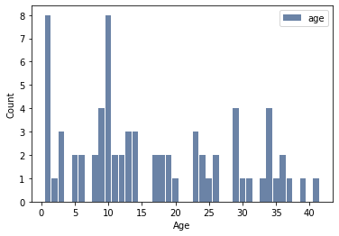
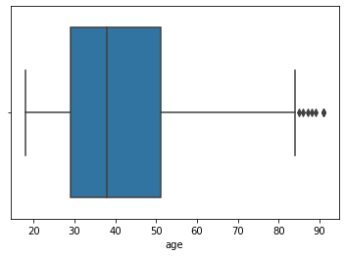
Age
This variable represents the age of individuals.
Skewed right with a many outliers
Mean: 41.37835570469799 Median: 38.0 Mode: 32

Slide 8
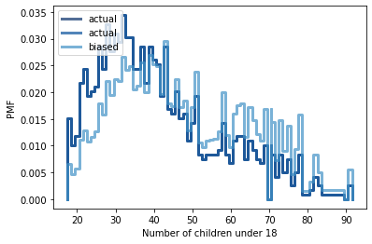
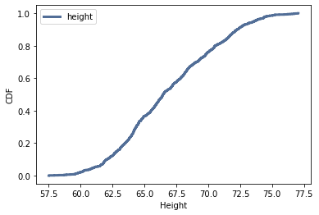
Height PMF and CDF
The cumulative probability at a certain height is seen through this cumulative distribution function

Slide 9
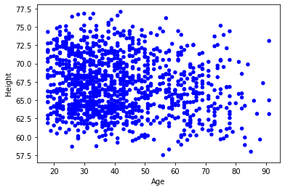
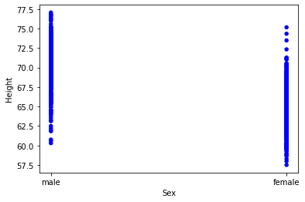
Analytical Distribution and Scatterplots
Cor -0.13651458389152527 SpearmanCor -0.11741428808227329
Age doesn’t seem to have any relationship with the height of an individual because there is no apparent correlation and it is non linear.
Correlation does not mean Causation
Sex does seem to have a relationship with the height of an individual because male tends to have a higher mean height than females. So sex has a correlation towards height, males are favored by this scatterplot.

Slide 10
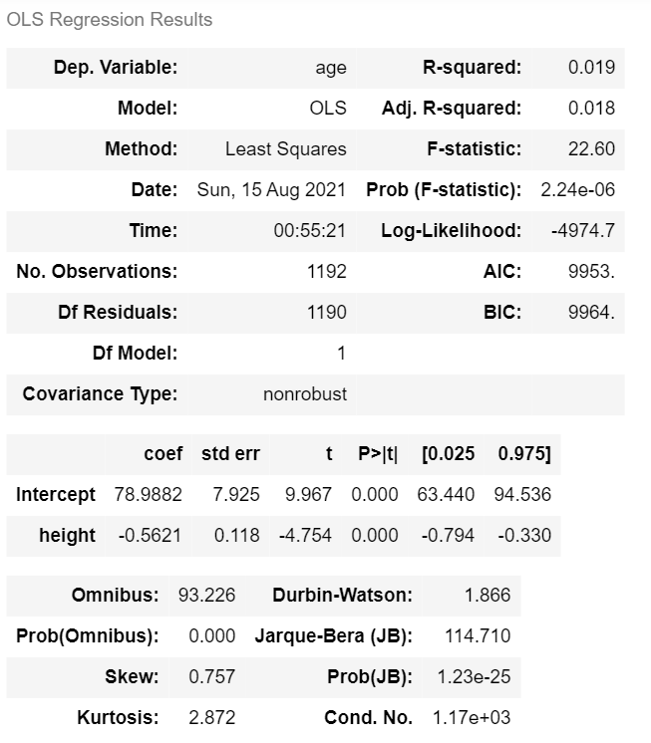
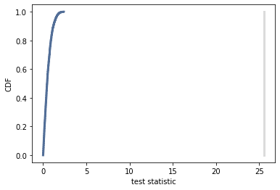
Hypothesis Test and Regression Analysis
The p value is 0 because the test statistic does not intersect the cdf. This means that there I no difference in means between heights and age, asserting our initial thoughts that age does not affect height, especially after 20.

Slide 11
Conclusion
We examined 5 different variables relating to height of individuals
We noticed that age doesn’t affect height (after 20).
We noticed that sex has an effect on height in terms of male mean height is higher than female mean height
We used various different stastical analysis techniques to explore this data
This class has taught me a lot, thanks for the great class!

